Slide 1
Insurance – Claim Processing Durations

Slide 2
Australian Insurance Industry
Australian insurance industry forms a significant part of the Australian financial sector, and is regulated by two bodies – APRA and ASIC
Claim processing duration is dependent on a multitude of factors, such as insurance provider, the type of insurance cover, any disputes etc. Insurers generally aim to process claims efficiently and fairly
The ability to process claims efficiently and provide insured funds is a major contributor to consumer satisfaction

Slide 3
Data Source
INSURANCE PROVIDER
21 insurance providers including AIA, Allianz, Westpac, MLC Limited
DISTRIBUTION CHANNEL
Method insurance made available:
Individual advised: seeking advice from experts obtain personalised coverage
Individual non-advised: individuals making decisions independently, standardized, off-the-shelf policies
Group ordinary: commonly offered by employers, basic, standardized life insurance benefits with lower premiums
Group super: more customization options and higher premiums than group ordinary
COVER TYPE
CCI: Consumer Credit Insurance - cover for consumers who are unable to meet their minimum loan repayments
Accident: payout when people experience injury or death due to an accident
Death: lump sum amount of money at death
DII: Disability Insurance - provides financial support if you can't work due to a disability or illness.
Funeral: provides your family with a lump sum payment to fund funeral expenses if you die
TPD: Total Permanent Disability - provides financial protection if you become totally and permanently disabled due to an injury or illness
Trauma: also known as critical illness insurance, provides a lump sum if you suffer a critical illness or serious injury

Slide 4
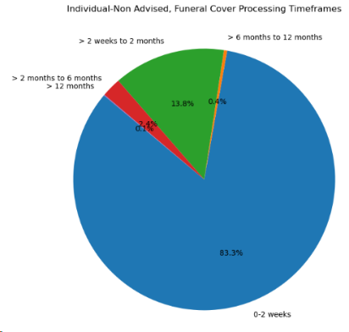
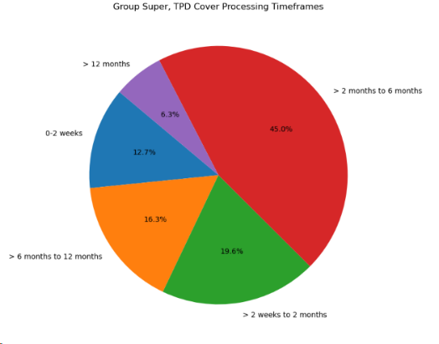
Preliminary Data Analysis
Processing Timeframes for funeral cover (individual non-advised)
Processing Timeframes for TPD cover (group super)

Slide 5
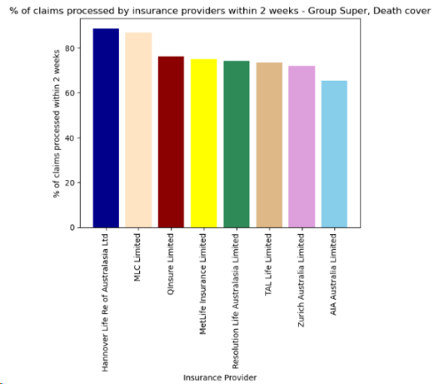
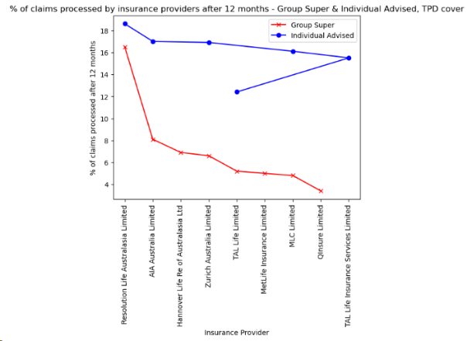
Preliminary Data Analysis
Quickest insurers for death cover (group super)
Slowest insurers for TPD cover (group super & individual advised)

Slide 6
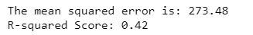
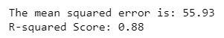
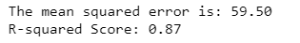

Machine learning
linear regression
random forest regression
decision tree regression
knn regression

Slide 7
Machine learning
linear regression
random forest regression
decision tree regression
knn regression

Slide 8
Thank you ☺

